Slide 1
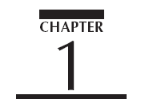


Slide 2
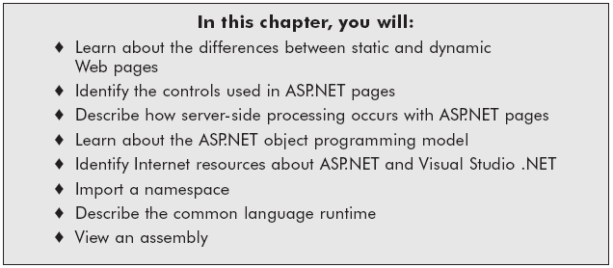
Chapter Objectives

Slide 3
Static and Dynamic Web Applications
Static Web pages
  Created with HTML controls
Dynamic Web pages
  Allow user to interact with the Web page
  Changes appearance or content
  Created with Microsoft’s Active Server Pages .NET (ASP.NET)
    Used to build server-side Web applications

Slide 4
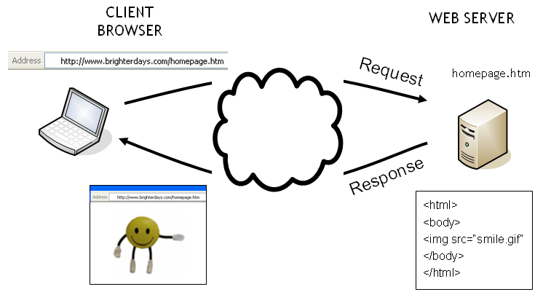
Processing a Request for a Web Page

Slide 5
ASP.NET
Main ASP.NET applications
  Web Forms
    Used to process forms and develop cross-browser applications
    Uses .aspx file extension
  Web Services
    Other applications can interact with your program
    Uses .asmx file extension

Slide 6
Web Forms
ASP.NET pages within an ASP.NET application
  Identified with file extension .aspx
2 logical areas:
  HTML template
    Contains design layout, content, and controls
  Collection of code commonly located behind Web Form

Slide 7
HTML Server Controls
Similar to HTML controls except processed by server
Write runat=“server” to transform HTML control into HTML Server control
Controls have closing tag, or end with />
HTML control:
  <input type=“text”>
HTML Server control:
  <input type=“text” runat=“server” />

Slide 8
ASP.NET Server Controls
Creates HTML code
ASP.NET controls usually identified with prefix asp: followed by name of the control
<asp:Button id=“ShowBtn” runat=“server” Text=“Show the message.” />
Types of ASP.NET Server Controls
  ASP.NET Form Controls (Web controls): Create controls that render HTML output and that provide more flexibility.
  Data Validation Controls: Validate form data
  User Controls: Used to create self-contained code, headers, etc.
  Mobile Controls: provide form functionality within wireless and mobile devices

Slide 9
HTML Server Versus ASP.NET Server Controls
ASP.NET form controls also have different properties than their HTML server control counterparts
HTML Server label control
  Message1.InnerHTML = "Product 1"
ASP server label control
  Message2.Text = "Product 2"

Slide 10
Browser Source Code
Look at the browser’s source code for each ASP.NET page to understand what the Web server is sending to the browser
  ASP.NET code is never sent to the browser
  Only HTML tags, along with client-side scripts, are sent to the browser (e.g., www.dell.com)
Many errors are related to the syntax of the HTML that is sent to the browser, such as a missing closing tag, or a missing quotation mark
You can quickly locate HTML syntax errors

Slide 11
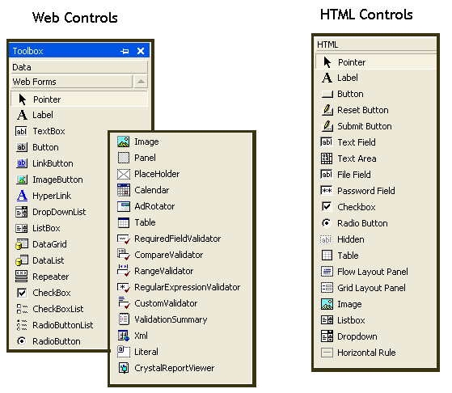
Server Controls within Visual Studio .NET

Slide 12
Code Behind the Page
Written in an ASP.NET-compatible language
File extension is .vb if code is written in Visual Basic .NET
Compiled code behind the page is the class definition for the page
When you build the application, you compile the code into an executable file stored in the bin directory

Slide 13
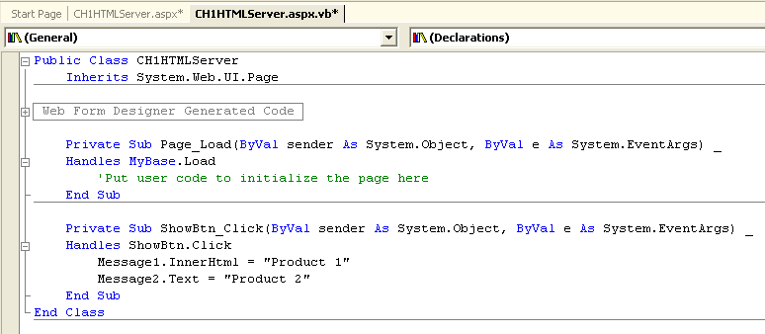
The Code Behind the Page

Slide 14
Postback
Posting back data into form
The _ViewState hidden form field
  Very long encoded string
  Contains information required to maintain form data across multiple page requests
  Value changes each time form is reposted
EnableViewState property
  Turns postback feature on or off. To turn off:
  <%@ Page EnableViewState="false" %>
Notes:
The postback events work by calling the postback method with the control id passed.

Slide 15
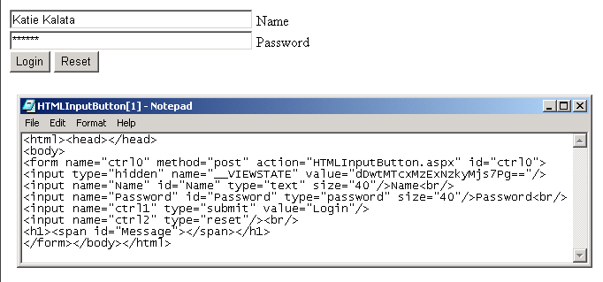
Postback data using the
_ViewState hidden field

Slide 16
Page Class Events
The first time a page is requested by a client, a series of page events occurs
  Page_Init – initializes page control hierarchy
  Page_Load – loads any server controls into memory and occurs every time page is executed
  Server control events – action and change events occur when page is posted back to the server
  Page_PreRender – occurs immediately before control hierarchy is rendered and sent to the browser
  Page_Unload –removes page from server’s memory

Slide 17
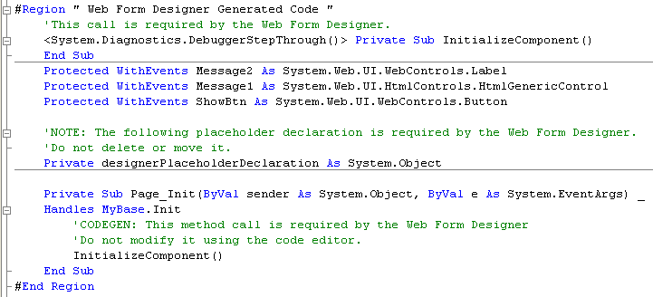
Page Class Event Cycle

Slide 18
Page_Load Event Procedure
Begin procedure with keyword Sub
End procedure with keywords End Sub
  Sub Page_Load(s As Object, e As EventArgs)
    Message.InnerHtml = “Welcome!”
  End Sub

Slide 19
Server Control Events
When user clicks the button, an OnServerClick event handler is called
    <input type= "button" Value= "Click Me!" id="MyBtn" runat="server" OnServerClick="MyBtn_Click">
Client side onClick triggers event that returns a server click event
    <button language = "javascript" onClick="_doPostback('MyBtn',‘ ')" id="MyBtn" "Click Me!“
    </button>

Slide 20
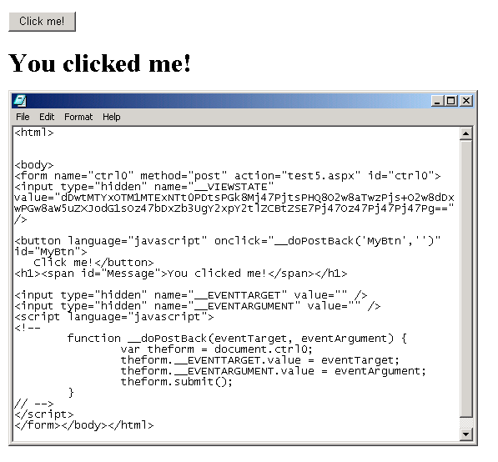
Interacting with the Code Behind the Page

Slide 21
Server Control Events (continued)
Code behind the page sends a message back to the browser
  Sub MyBtn_Click(sender As Object, E as EventArgs)
    Message.InnerHtml = "You clicked me! "
  End Sub

Slide 22
Trace Property
View Server controls and Server variables
On the first line in the HTML template enter
  <%@ Page Trace = "true" %>
Control Tree
  ID represents property of the control
    Controls with no name are assigned an ID
  Non-server controls are assigned as a Literal control

Slide 23
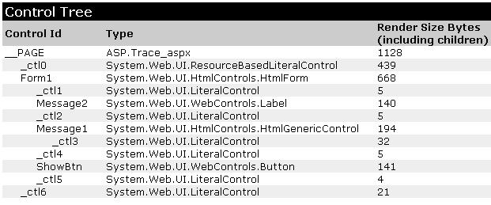
The Page Class Control Tree

Slide 24
Page.Request Property
HTTP header packet contains information about the HTTP request
  User agent is used to identify the client software
Request object retrieves header information as server variables
  Request.UserHostAddress (client IP address)
  Request.Browser.Browser (browser name)

Slide 25
Page.Request Property (continued)
Request property contains a Form collection and QueryString collection that allow you to collect form information from both methods

Slide 26
QueryString
If form method is GET, form is sent appended to the URL requested as a single string called the QueryString
Separated from URL with question mark (?)
http://www.tarastore.com/index.asp?name=katie&topic=asp

Slide 27
Retrieving Form Values from the QueryString Collection
Sample form field
  <input id="PWD" type="password" size="8" runat="server">
Querystring
  http://www.tarastore.com/index.aspx?PWD=MyPassword
Retrieve the password
  Request.QueryString("PWD")

Slide 28
Retrieving Form Values from the Form collection
If the form method is POST, it is sent as part of the HTTP request body
  Request.Form("PWD")

Slide 29
Direct Access to Form Values
A simpler method to retrieve the value from a form field is to directly access the value properties of the form field
  If (PWD.Value = "Course") Then
    Message.InnerHtml = "Welcome!"
  Else
    Message.InnerHtml = "Try again!"
  End If

Slide 30
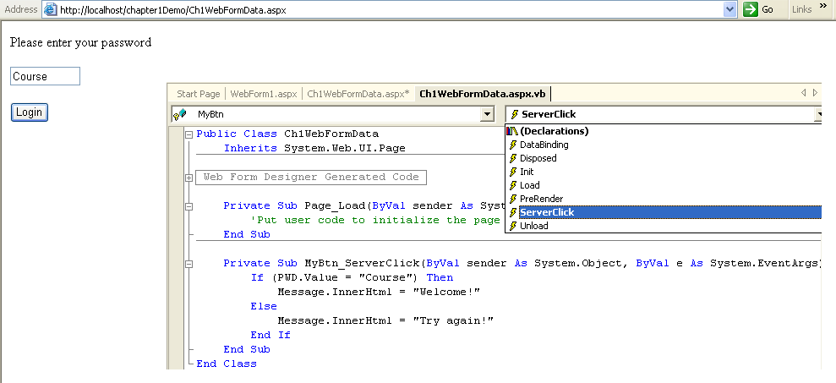
Retrieving Form Values and Server Variables

Slide 31
Page.Response Property
Response.Write(string)
  Writes the value of the string to the Web page
  Response.Write("Copyright by TaraStore<br/>")
Response.WriteFile(file path)
  Sends the entire contents of a text file to the Web page
  Response.WriteFile("c:\copyright.txt")

Slide 32
Page.Response Property (continued)
Response.Redirect(URL)
  Sends the browser to another page
  Response.Redirect("http://www.course.com/")

Slide 33
Locating Your ASP.NET Application
Web Server is called Internet Information Server
  C:/Inetpub/wwwroot maps to http://localhost/
Develop on local Web server or test server
Deploy Web application to production Web server on the Internet
You can transfer Web application files using File Transfer Programs (FTP)

Slide 34
Web Services
Exposes part of a program over the Internet
Web Service file has .asmx file extension
Uses open standards so it’s supported across applications and platforms
Used to create business-to-business applications
Can share data with other partners

Slide 35
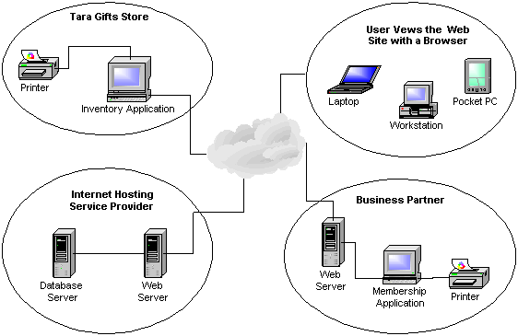
The Tara Store Web Service

Slide 36
The .NET Framework
An architectural model for creating programs that interface with the operating system and base class libraries
Contains a hierarchical set of Base Class Libraries
Base class libraries are code libraries that provide general functions

Slide 37
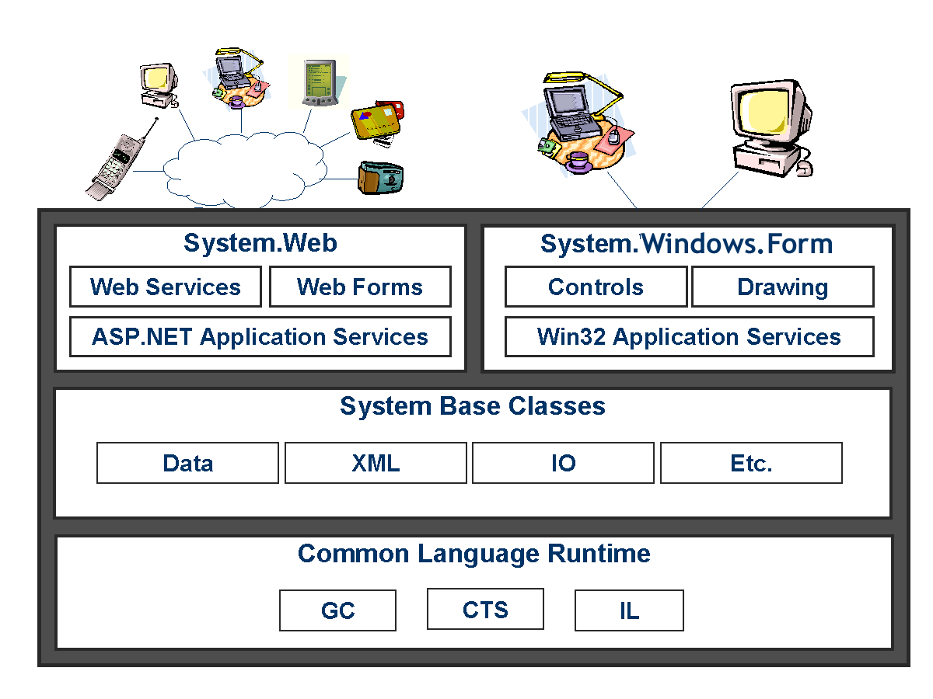
The .NET Framework
Notes:
GC – Garbage Collection
CTS – Common Type System
IL – Microsoft Intermediate Language
CLR – Common Language Runtime
JIT or JITter – Just IN Time compiler

Slide 38
Namespaces
Organizes base class libraries
Top namespace is System
All Web Forms inherit the System.Web.UI namespace
System.Web.UI contains classes for controls used on Web Forms
  HTML Server controls
  ASP.NET Server controls (Web controls)

Slide 39
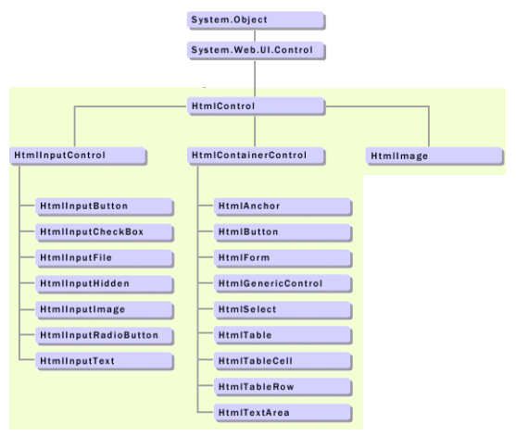
The HTML Server controls
Notes:
See http://msdn.microsoft.com/library/default.asp?url=/library/en-us/cpref/html/frlrfsystemwebuihtmlcontrolshierarchy.asp
You don’t have to import the System, System.Collections, System.Collections.Specialized, System.Configuration, System.Text, System.Text.RegularExpressions, System.Web, System.Web.Caching, System.Web.Security, System.Web.SessionState, System.Web.UI, System.Web.UI.HTMLControls, or System.Web.UI.WebControls namespaces in an ASP.NET page because these namespaces are automatically imported by default. However, a Visual Basic class file does not have default namespaces.

Slide 40
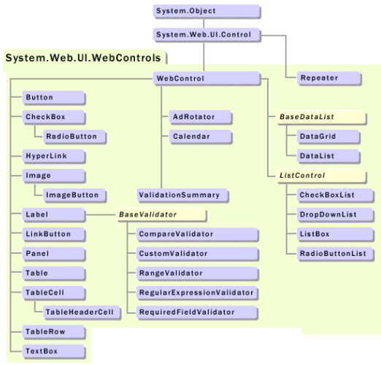
The ASP.NET Server controls
Notes:
See http://msdn.microsoft.com/library/default.asp?url=/library/en-us/cpref/html/frlrfsystemwebuiwebcontrolswebcontrolclasstopic.asp
You don’t have to import the System, System.Collections, System.Collections.Specialized, System.Configuration, System.Text, System.Text.RegularExpressions, System.Web, System.Web.Caching, System.Web.Security, System.Web.SessionState, System.Web.UI, System.Web.UI.HTMLControls, or System.Web.UI.WebControls namespaces in an ASP.NET page because these namespaces are automatically imported by default. However, a Visual Basic class file does not have default namespaces.

Slide 41
Common Language Runtime
Common Language Runtime (CLR) is used to achieve language independence
Each .NET language provides a compiler that supports the CLR through the Common Type System (CTS) which requires that all applications built within .NET support the same basic data types such as strings and integers
When the program code is compiled, the code is transformed into an intermediate language called the Microsoft Intermediate Language (IL). No matter what language is used to create the program, the IL created may be the same
The compiled .NET program is called assembly. It contains the intermediate language along with additional information describing the content of the IL called metadata

Slide 42
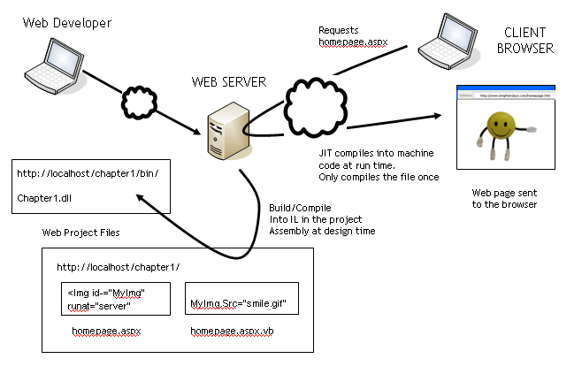
Building the application

Slide 43
IL Disassembler (ILDASM)
View assembly using ILDASM
Displays intermediate language
Can view information about namespaces, classes, and other programming structures

Slide 44
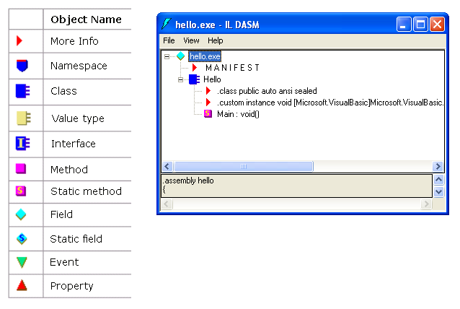
Using the ILDASM
Notes:
A manifest describes the relationship between the elements listed in the assembly

Slide 45
Other Resources
Sample Web Sites
  http://www.asp.net/CommerceStarterKit/
Developer Resources
  www.asp.net
QuickStart Web site
  localhost/quickstart/
  samples.gotdotnet.com/quickstart

Slide 46
Summary
ASP.NET pages can contain programs written in a variety of programming languages.
Web Forms end in .aspx. Web Services end in .asmx. User controls end in .ascx.
The term “ASP.NET pages” and “Web Forms” are synonymous.
The entire ASP.NET Web page is a class called the Page class.
The .NET framework is the architectural framework in which ASP.NET applications are created.

Slide 47
Summary (continued)
Web Services allow you to expose a program interface publicly to other businesses and applications.
At compile time, all languages must support the same common .NET data types.
Page class renders HTML and Server code to the browser.
The Page class contains the code behind the page, which is located in a separate file.
You need a Web server to post your pages and a platform that supports the .NET Framework.
There are a variety of help resources within Visual Studio .NET and on the Internet.

